Slide 1












$$r\left(x\right)$$
$$r\left(x\right)$$
$$𝒞$$
$$g\left(x\right)$$
$$g\left(x\right)$$
Update $u^{t+1}←w^{t}−η_{t}⋅g^{t}$
Project $w^{t+1}←Π_{𝒞}\left(u^{t+1}\right)$
$\min_{x}{f\left(x\right)}$ s.t. $g\left(x\right)≤0$
$$Π_{𝒞}\left(x\right)≝\arg{\min_{z∈𝒞}{{\left\|x−z\right\|}_{2}^{2}}}$$
$$\min_{x}{f\left(x\right)}+r\left(x\right)$$
$$\min_{w}{f\left(w\right)}$$
s.t. $w∈𝒞$
The projection step may be very expensive unless the constraint set is simple
Approximate barriers may distort the objective and struggle to handle equality constraints

Slide 2
the dazzling domain of duals
No tree can ascend to dizzying heights until its roots drill down to profound depths
– adapted from Aion: Untersuchungen zur Symbolgeschichte, Carl Jung (1951)

Slide 3




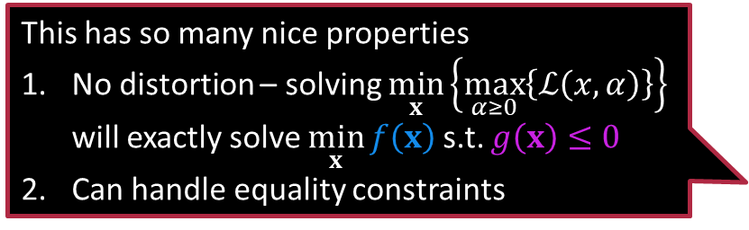




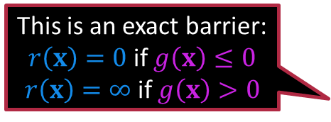
The Lagrangian
The expression $ℒ\left(x,α\right)≝f\left(x\right)+α⋅g\left(x\right)$ is called the “Lagrangian” of the optimization problem $\min_{x}{f\left(x\right)}$ s.t. $g\left(x\right)≤0$
This has so many nice properties
No distortion – solving $\min_{x}\left\{\max_{α≥0}\left\{ℒ\left(x,α\right)\right\}\right\}$ will exactly solve $\min_{x}{f\left(x\right)}$ s.t. $g\left(x\right)≤0$
Can handle equality constraints
Recall that we are trying to solve $\min_{x}{f\left(x\right)}$ s.t. $g\left(x\right)≤0$
Technique 3 (Exploit Duality):
Use exact barrier functions and rewrite the problem
Exact barrier: $g\left(x\right)≤0⟶r\left(x\right)=\max_{α≥0}{α⋅g\left(x\right)}$ $h\left(x\right)≥0⟶r\left(x\right)=\max_{β≤0}{β⋅h\left(x\right)}$ $e\left(x\right)=0⟶r\left(x\right)=\max_{γ∈ℝ}{γ⋅e\left(x\right)}$
We now solve $\min_{x}\left\{f\left(x\right)+\max_{α≥0}{α⋅g\left(x\right)}\right\}$
Same as solving $\min_{x}\left\{\max_{α≥0}\left\{f\left(x\right)+α⋅g\left(x\right)\right\}\right\}$
Be careful … $α,β,γ$ are not regularization constants
$$r\left(x\right)$$
We may have a constraint $α≥0$ remaining but it is such a simple one
$$g\left(x\right)$$
This is an exact barrier: $r\left(x\right)=0$ if $g\left(x\right)≤0$ $r\left(x\right)=∞$ if $g\left(x\right)>0$

Slide 4





The Dual Problem
Be careful – the dual simply changes the order of the min-max operations. It is still min over $x$ and max over $α≥0$. Don’t make the mistake of creating the dual as $\max_{x}\left\{\min_{α≥0}\left\{f\left(x\right)+α⋅g\left(x\right)\right\}\right\}$ or $\min_{α≥0}\left\{\max_{x}\left\{f\left(x\right)+α⋅g\left(x\right)\right\}\right\}$
Since we used an exact barrier, we will always have
$\min_{x}{f\left(x\right)}$ s.t. $g\left(x\right)≤0$
$≡$
$\min_{x}\left\{\max_{α≥0}\left\{f\left(x\right)+α⋅g\left(x\right)\right\}\right\}$
However, if $f,g$ are “nice” then the above two are identical to
$≡$
$\max_{α≥0}\left\{\min_{x}\left\{f\left(x\right)+α⋅g\left(x\right)\right\}\right\}$
Proving that the 2nd and 3rd problems are identical involves a result called “strong duality” – beyond the scope of this discussion.
But what did we gain by creating this dual problem?
Primal Optimization Problem
Primal Optimization Problem
Often, the (unconstrained) inner problem in the dual i.e., $\min_{x}\left\{f\left(x\right)+α⋅g\left(x\right)\right\}$ can be solved simply by applying FOO ☺
Dual Optimization Problem

Slide 5

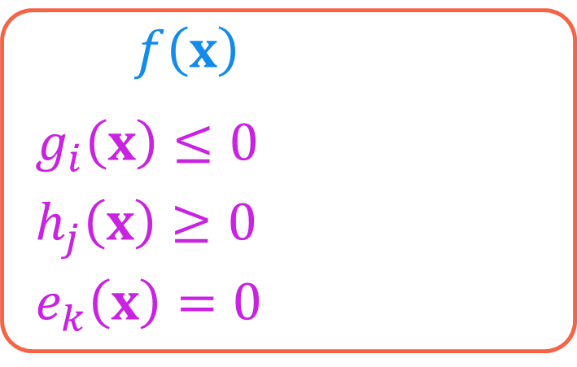

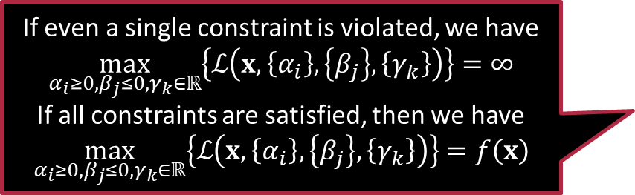

How to create the Dual
$\min_{x}{f\left(x\right)}$ s.t.
$g_{i}\left(x\right)≤0$, $i=1,…,m$
$h_{j}\left(x\right)≥0$, $j=1,…,n$
$e_{k}\left(x\right)=0$, $k=1,…,z$
Step 0: Ensure that we have a min problem
Else convert it into one by negating the obj
Step 1: introduce a variable for each constraint $α_{1},…,α_{m},β_{1},…,β_{n},γ_{1},…γ_{z}$
These variables are called “dual” variables or else “Lagrange multipliers”
Step 2: Create the Lagrangian $ℒ\left(x,\left\{α_{i}\right\},\left\{β_{j}\right\},\left\{γ_{k}\right\}\right)≝f\left(x\right)+\sum_{i∈\left[m\right]}{α_{i}⋅g_{i}\left(x\right)}+$
$$\sum_{j∈\left[n\right]}{β_{j}⋅h_{j}\left(x\right)}+\sum_{k∈\left[z\right]}{γ_{k}⋅e_{k}\left(x\right)}$$
If even a single constraint is violated, we have $$\max_{α_{i}≥0,β_{j}≤0,γ_{k}∈ℝ}\left\{ℒ\left(x,\left\{α_{i}\right\},\left\{β_{j}\right\},\left\{γ_{k}\right\}\right)\right\}=∞$$
If all constraints are satisfied, then we have $$\max_{α_{i}≥0,β_{j}≤0,γ_{k}∈ℝ}\left\{ℒ\left(x,\left\{α_{i}\right\},\left\{β_{j}\right\},\left\{γ_{k}\right\}\right)\right\}=f\left(x\right)$$
In contrast, the variables of the original problem i.e., $x$ in this case, are called the primal variables

Slide 6

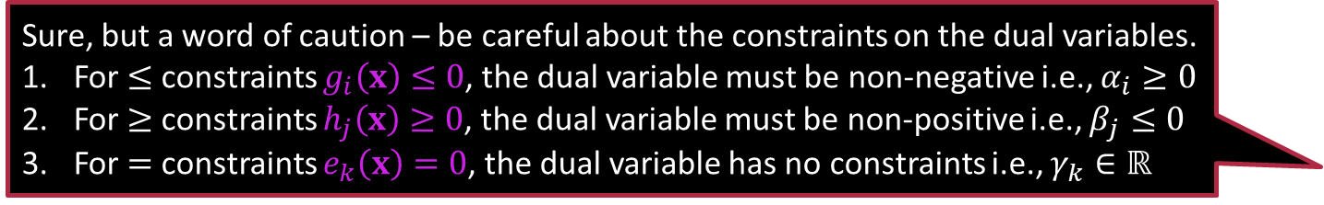


Creating the Dual
Solving
Once I have solved the dual, how do I get the solution to the original problem i.e., $x^{∗}$
$\min_{x}{f\left(x\right)}$ s.t.
$g_{i}\left(x\right)≤0$, $i=1,…,m$
$h_{j}\left(x\right)≥0$, $j=1,…,n$
$e_{k}\left(x\right)=0$, $k=1,…,z$
Step 3: inspect the primal problem
$\min_{x}\left\{\max_{α_{i}≥0,β_{j}≤0,γ_{k}∈ℝ}{ℒ\left(x,\left\{α_{i}\right\},\left\{β_{j}\right\},\left\{γ_{k}\right\}\right)}\right\}$
Step 4: create the dual problem
$\max_{α_{i}≥0,β_{j}≤0,γ_{k}∈ℝ}\left\{\min_{x}{ℒ\left(x,\left\{α_{i}\right\},\left\{β_{j}\right\},\left\{γ_{k}\right\}\right)}\right\}$
Step 5: Try to solve $\min_{x}{ℒ\left(x,\left\{α_{i}\right\},\left\{β_{j}\right\},\left\{γ_{k}\right\}\right)}$ in closed form
Let $q\left(\left\{α_{i}\right\},\left\{β_{j}\right\},\left\{γ_{k}\right\}\right)≝$ $\min_{x}{ℒ\left(x,\left\{α_{i}\right\},\left\{β_{j}\right\},\left\{γ_{k}\right\}\right)}$
Step 6: Solve the simplified dual $\max_{α_{i}≥0,β_{j}≤0,γ_{k}∈ℝ}\left\{q\left(\left\{α_{i}\right\},\left\{β_{j}\right\},\left\{γ_{k}\right\}\right)\right\}$
Can you also give us some examples of simplifying the dual?
Sure, but a word of caution – be careful about the constraints on the dual variables.
For $≤$ constraints $g_{i}\left(x\right)≤0$, the dual variable must be non-negative i.e., $α_{i}≥0$
For $≥$ constraints $h_{j}\left(x\right)≥0$, the dual variable must be non-positive i.e., $β_{j}≤0$
For $=$ constraints $e_{k}\left(x\right)=0$, the dual variable has no constraints i.e., $γ_{k}∈ℝ$

Slide 7


Example 1: Ridge Regression
We collected all residuals $r_{i}$, dual variables $α_{i}$ and labels $y^{i}$ into $n$-dimensional vectors $r,α,y∈ℝ^{n}$ respectively. We similarly collected all features $x^{i}$ into a matrix $X∈ℝ^{n×d}$
$$\min_{w∈ℝ^{d}}{\frac{1}{2}{\left\|w\right\|}_{2}^{2}}+\sum_{i=1}^{n}{{\left(y^{i}−w^{⊤}x^{i}\right)}^{2}}$$
This problem has no constraints – lets introduce some ☺ $\min_{w∈ℝ^{d}}{\frac{1}{2}{\left\|w\right\|}_{2}^{2}}+\sum_{i=1}^{n}{r_{i}^{2}}$
s.t. $y^{i}−w^{⊤}x^{i}=r_{i}$ for all $i∈\left[n\right]$
Step 0: Already a minimization problem – nothing to do!
Step 1: Introduce dual variables $α_{1},…,α_{n}∈ℝ$ (no constraints on $α_{i}$)
Step 2: Create the Lagrangian $ℒ\left(w,r,α\right)=\frac{1}{2}{\left\|w\right\|}_{2}^{2}+{\left\|r\right\|}_{2}^{2}+α^{⊤}\left(y−Xw−r\right)$

Slide 8




Example 1: Ridge Regression
Remember, we have two vector primal variables here $w,r$ and one vector dual variable $α$
There you go – this is how we will recover the optimal values of the primal variables once we recover solve the dual problem.
Step 4: Create the dual $\max_{α}\left\{\min_{w,r}{ℒ\left(w,r,α\right)}\right\}$
Step 5: Simplify the dual $q\left(α\right)=\min_{w,r}{ℒ\left(w,r,α\right)}=\min_{w,r}\left\{\frac{1}{2}{\left\|w\right\|}_{2}^{2}+{\left\|r\right\|}_{2}^{2}+α^{⊤}\left(y−Xw−r\right)\right\}$
Apply FOO as this is an unconstrained problem with differentiable objective $\frac{∂ℒ}{∂w}=0⇒w=X^{⊤}α$ and $\frac{∂ℒ}{∂r}=0⇒r=α/2$
Substituting these expressions for $w$ and $r$ into the Lagrangian gives us $q\left(α\right)=−\frac{1}{2}α^{⊤}XX^{⊤}α−\frac{1}{4}{\left\|α\right\|}_{2}^{2}+α^{⊤}y$
No constraints on $α$ as it corresponds to equality constraints

Slide 9

Example 1: Ridge Regression
Step 6: Solve the simplified dual $\max_{α}{q\left(α\right)}≡\min_{α}{−q\left(α\right)}≡\min_{α}{\frac{1}{4}α^{⊤}\left(2XX^{⊤}+I_{n}\right)α−α^{⊤}y}$
where $I_{n}∈ℝ^{n×n}$ is the $n$-dimensional identity matrix
Note: we can apply FOO to solve this simplified dual as well ☺ $\frac{∂q}{∂α}=0⇒α^{∗}=2{\left(2XX^{⊤}+I_{n}\right)}^{−1}y$
Use the fact that the matrix $\left(2XX^{⊤}+I_{n}\right)$ is always invertible
Step 7: Retrieve the optimal primal variables $w^{∗}=X^{⊤}α^{∗}=2X^{⊤}{\left(2XX^{⊤}+I_{n}\right)}^{−1}y$ $r^{∗}={α^{∗}}/2={\left(2XX^{⊤}+I_{n}\right)}^{−1}y$

Slide 10



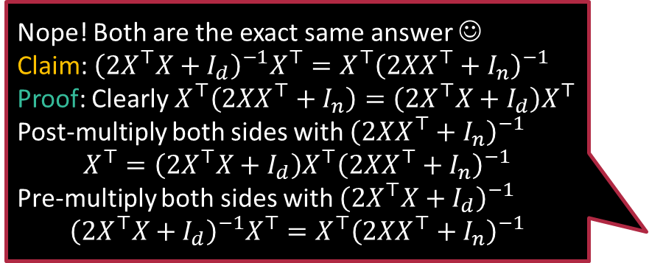

A bit of Gyan
Also recall that you had designed a CD/CM solver for ridge regression as an exercise problem. Sometimes, descent-based solvers are faster even if closed-form solutions are available
Why are we solving the same problem in so many ways? $\min_{w∈ℝ^{d}}{\frac{1}{2}{\left\|w\right\|}_{2}^{2}}+\sum_{i=1}^{n}{{\left(y^{i}−w^{⊤}x^{i}\right)}^{2}}$
FOO on primal problem gives us $w^{∗}=2{\left(2X^{⊤}X+I_{d}\right)}^{−1}X^{⊤}y$
$I_{d}∈ℝ^{d×d}$ is the $d$-dimensional identity matrix
Solving the dual problem gives us $w^{∗}=2X^{⊤}{\left(2XX^{⊤}+I_{n}\right)}^{−1}y$
$I_{n}∈ℝ^{n×n}$ is the $n$-dimensional identity matrix
The reason is time complexity
Computing $2{\left(2X^{⊤}X+I_{d}\right)}^{−1}X^{⊤}y$ takes $𝒪\left(d^{2}n+d^{3}\right)$ time
Computing $2X^{⊤}{\left(2XX^{⊤}+I_{n}\right)}^{−1}y$ takes $𝒪\left(n^{2}d+n^{3}\right)$ time
Use primal solution if $n>d$ and dual solution if $d>n$ ☺
Nope! Both are the exact same answer ☺
Claim: ${\left(2X^{⊤}X+I_{d}\right)}^{−1}X^{⊤}=X^{⊤}{\left(2XX^{⊤}+I_{n}\right)}^{−1}$
Proof: Clearly $X^{⊤}\left(2XX^{⊤}+I_{n}\right)=\left(2X^{⊤}X+I_{d}\right)X^{⊤}$
Post-multiply both sides with ${\left(2XX^{⊤}+I_{n}\right)}^{−1}$ $$X^{⊤}=\left(2X^{⊤}X+I_{d}\right)X^{⊤}{\left(2XX^{⊤}+I_{n}\right)}^{−1}$$
Pre-multiply both sides with ${\left(2X^{⊤}X+I_{d}\right)}^{−1}$ $${\left(2X^{⊤}X+I_{d}\right)}^{−1}X^{⊤}=X^{⊤}{\left(2XX^{⊤}+I_{n}\right)}^{−1}$$
All that is fine, but I see a problem. The $w^{∗}$ returned by FOO on primal and dual are not the same. Is one answer wrong?

Slide 11





The QUIN Trick
Warning: finding an unconstrained solution and doing a projection step does not give the correct solution in general.
I find this trick so cute that I think I will copyright the name QUIN – you have been warned!
Allows us to minimize a QUadratic over an INterval in closed form ☺
The solution to this problem is always
$x^{∗}=Π_{\left[a,b\right]}\left({−q}/{2p}\right)$
$=\left\{\begin{matrix}\begin{matrix}{−q}/{2p} & if {−q}/{2p}∈\left[a,b\right]\end{matrix} \\ \begin{matrix}a & if {−q}/{2p}<a\end{matrix} \\ \begin{matrix}b & if {−q}/{2p}>b\end{matrix}\end{matrix}\right.$
Basically, find the solution ignoring the constraints, then project onto the interval ☺
Can you prove this result as a theorem?
Hint: first prove for the special case ${\left(x−c\right)}^{2}$ then use completion of squares to extend to general cases
$\min_{x}{{px}^{2}+qx+r}$
s.t. $x∈\left[a,b\right]$
In fact, this trick will not work for general quadratic objectives and box constraints even in 2D. It only works in 1D.
$a$ $b$

Slide 12





Example 2: Elastic Net
$1∈ℝ^{d}$ denotes all-ones vector and $r>0$ is some real constant
You could add such a constraint, but it would be redundant. If $z_{i}<0$ then $x_{i}−z_{i}≤0$ and $x_{i}+z_{i}≥0$ can never be true simultaneously so negative values of $z_{i}$ are auto-eliminated
$$\min_{x∈ℝ^{d}}{{\left\|x\right\|}_{1}+\frac{1}{2}{\left\|x\right\|}_{2}^{2}}$$ s.t. $x^{⊤}1≥r$
The objective has a non-differentiable term – painful ☹
In this special case, we can remove the non-differentiability ☺
$$\min_{x∈ℝ^{d}}{\sum_{i∈\left[d\right]}{z_{i}}+\frac{1}{2}{\left\|x\right\|}_{2}^{2}}$$ s.t. $x^{⊤}1≥r$ $x_{i}−z_{i}≤0$ for all $i∈\left[d\right]$ $x_{i}+z_{i}≥0$ for all $i∈\left[d\right]$
Notice how this trick somewhat moves the objective into the constraints ☺
Oh! $z_{i}$ is meant to stand for $\left|x_{i}\right|$ and the two constraints ensure this. Quick question: should we not have a $z_{i}≥0$ constraint as well?

Slide 13



Example 2: Elastic Net
We collected absolute values $z_{i}$, dual variables $β_{i}$ and $γ_{i}$ into $d$-dimensional vectors $z,β,γ∈ℝ^{d}$ respectively.
For sake of uniformity, we often rewrite $≥$ constraints as $≤$ constraints
$$\min_{x∈ℝ^{d}}{z^{⊤}1+\frac{1}{2}{\left\|x\right\|}_{2}^{2}}$$ s.t. $−\left(x^{⊤}1−r\right)≤0$
$x_{i}−z_{i}≤0$ for all $i∈\left[d\right]$
$−\left(x_{i}+z_{i}\right)≤0$ for all $i∈\left[d\right]$
Step 0: Already a minimization problem – nothing to do!
Step 1: Introduce dual variables $α≥0,β_{i}≥0,i∈\left[d\right],γ_{i}≥0,i∈\left[d\right]$
Step 2: Create the Lagrangian $ℒ\left(x,z,α,β,γ\right)=$ $z^{⊤}1+\frac{1}{2}{\left\|x\right\|}_{2}^{2}−α\left(x^{⊤}1−r\right)+β^{⊤}\left(x−z\right)−γ^{⊤}\left(x+z\right)$

Slide 14


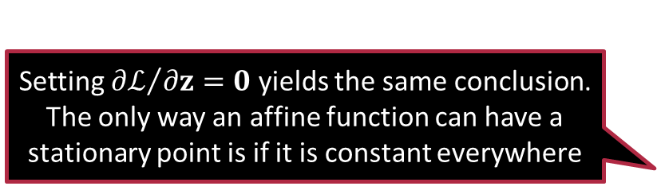

Example 2: Elastic Net
Remember, we have two primal vector variables here $x,z$, one scalar dual variable $α$ and two vector dual variables $β,γ$
Setting ${∂ℒ}/{∂z}=0$ yields the same conclusion. The only way an affine function can have a stationary point is if it is constant everywhere
Step 4: Create the dual $\max_{α≥0,β≥0,γ≥0}\left\{\min_{x,z}{ℒ\left(x,z,α,β,γ\right)}\right\}$
Step 5: Simplify the dual. We have $q\left(α,β,γ\right)=$ $\min_{x,z}\left\{z^{⊤}1+\frac{1}{2}{\left\|x\right\|}_{2}^{2}−α\left(x^{⊤}1−r\right)+β^{⊤}\left(x−z\right)−γ^{⊤}\left(x+z\right)\right\}$ $=\min_{x,z}\left\{\frac{1}{2}{\left\|x\right\|}_{2}^{2}+x^{⊤}\left(β−γ−α⋅1\right)+rα+z^{⊤}\left(1−β−γ\right)\right\}$
Applying FOO to minimize w.r.t. $x$ gives us $x=α⋅1−β+γ$
To minimize w.r.t. $z$, note that if $1−β−γ≠0$ then $\min_{z}{z^{⊤}\left(1−β−γ\right)}$ will shoot to $−∞$ which is useless since we want to maximize over $q\left(⋅\right)$
Thus, at the optimum we must have $β+γ=1$ i.e., $z^{⊤}\left(1−β−γ\right)=0$
We will use this identity to recover the optimal value of $x$ after solving the dual.

Slide 15



Example 2: Elastic Net
When eliminating a variable, do not forget about its constraint. It would not have been correct to just forget about the constraint $γ≥0$ since it corresponds to a non-trivial constraint $β≤1$
$0≤β≤1$ means all coordinates $β_{i}∈\left[0,1\right]$
Step 5: Simplify the dual continued …
Substituting expression for $x$ and gives us
$q\left(α,β,γ\right)=−\frac{1}{2}{\left\|α⋅1−β+γ\right\|}_{2}^{2}+rα$ s.t. $β+γ=1$
Step 6: Solve the simplified dual $\max_{α≥0,β≥0,γ≥0}{q\left(α,β,γ\right)}≡\min_{\begin{aligned}α≥0,β≥0,γ≥0 \\ β+γ=1\end{aligned}}{\frac{1}{2}{\left\|α⋅1−β+γ\right\|}_{2}^{2}−rα}$
Eliminate $γ$ by setting $γ=1−β$. Also eliminate the constraint $γ≥0$ by introducing the constraint $1−β≥0$ i.e., $β≤1$
$$\min_{α≥0,0≤β≤1}{\frac{1}{2}{\left\|α⋅1+1−2⋅β\right\|}_{2}^{2}−rα}$$
The QUIN trick tells us that for a fixed value of $α>0$, the optimal value of $β_{i}$ w.r.t. is given by $β_{i}={\left(1+α\right)}/2$ if $α∈\left[0,1\right]$ and $β_{i}=1$ if $α>1$

Slide 16





Example 2: Elastic Net
Step 6: Solve the simplified dual continued …
$\min_{α≥0,0≤β≤1}{\frac{1}{2}{\left\|α⋅1+1−2⋅β\right\|}_{2}^{2}−rα}$
Putting these values in tells us that the objective value is $\left\{\begin{matrix} \begin{matrix} −rα & if α∈\left[0,1\right]\end{matrix} \\ \begin{matrix}{{d\left(α−1\right)}^{2}}/{2−rα} & if α>1\end{matrix}\end{matrix}\right.$
Applying QUIN tells us that the optimum is achieved at $α^{∗}=1+\frac{r}{d}>1$
This means that $β_{i}^{∗}=1$ as $α^{∗}>1$ which in turn gives $γ_{i}^{∗}=1−β_{i}^{∗}=0$
Step 7: Retrieve the optimal primal variables $x^{∗}=α^{∗}⋅1−β^{∗}+γ^{∗}=\left(\frac{r}{d}\right)⋅1=\left[\frac{r}{d},\frac{r}{d},…,\frac{r}{d}\right]$
Sanity check – we note that ${\left(x^{∗}\right)}^{⊤}1≥r$ i.e., original constraint satisfied
$$α$$
$$0 1$$
$$−r$$

Slide 17

Exercise
If $x,c∈ℝ^{d}$ are constant vectors and $r>0$ is a constant scalar,
Derive the projection rule for the ball by solving
$$\min_{z∈ℝ^{d}}{\frac{1}{2}⋅{\left\|x−z\right\|}_{2}^{2}}$$ s.t. ${\left\|z−c\right\|}_{2}^{2}≤r^{2}$
Derive the projection rule for the positive orthant by solving
$$\min_{z∈ℝ^{d}}{\frac{1}{2}⋅{\left\|x−z\right\|}_{2}^{2}}$$ s.t. $z_{i}≥0$

Slide 18

Exercise
Derive the projection rule for the general box by solving
$$\min_{z∈ℝ^{d}}{\frac{1}{2}⋅{\left\|x−z\right\|}_{2}^{2}}$$ s.t. $z_{i}∈\left[a_{i},b_{i}\right]$
Solve the following optimization problem
$$\min_{z∈ℝ^{d}}{\frac{1}{2}{\left\|z\right\|}_{2}^{2}}$$
s.t. $z^{⊤}1≥r$ $$z_{i}≥0$$

Slide 19

Summary
Explored several ways to solve constrained optimization problems
Projected descent
Barrier functions
Lagrangian dual
Explored the intricacies of how to derive the Lagrangian dual
Taking care of sign of dual variables depending on $≤,≥,=$ constraint
Taking care of constraints on variables if eliminating them
Two case studies
Modifying original problem to make it suitable to create dual
The QUIN rule for minimizing quadratics on an interval

Slide 20
Stay Awesome!
Join us in the next one.

